Slide 1
Course highlights
C programming / Embedded C programming
C++ programming
8/16/32 bit Microcontroller Peripherals and Interfacing on different development board
CAN expertise and good practical guidance in communication protocol by industrial trainers
In circuit serial communication and debugging techniques on different controllers
SDLC walkthrough : AGILE and Waterfall model
V model training along with AGILE practice

Slide 2
Practical exposure to system engineering and testing by industrial trainer
Project work on Software validation and system validation
Hands-on to communication protocols – RS232, SPI, I2C and CAN
Focus on good communication skills and team work during training. Soft skill training by industrial trainers
Daily class room and lab session for better practice
More focus on Automotive Embedded system design and development
Evaluation on weekly basis along with improvement guidance
Guidance on key topics by industrial experts

Slide 3
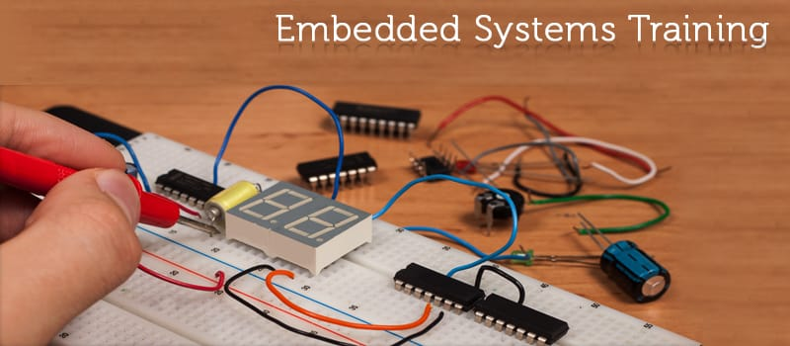
Design and development techniques

Slide 4
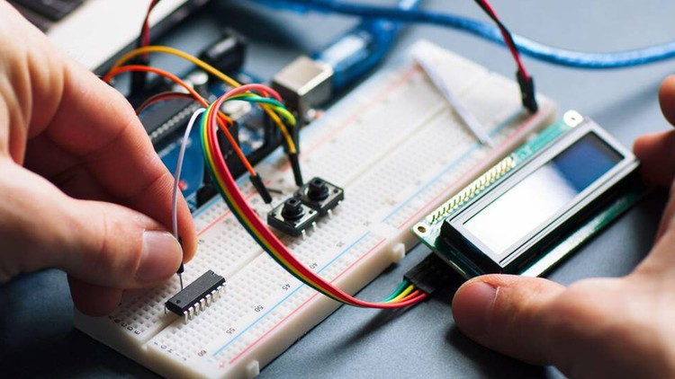

Slide 5
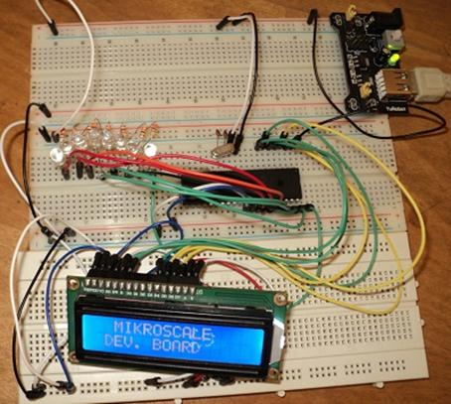

Slide 6
Course Status
Sr. No. | Technical Skills | Month | Status
1 | C/Embedded C programming | Oct-22 | Done
2 | C++ programming | Nov-22 | Done
3 | 8/16 bit Micro controller interfacing and programming | Nov-22 to Dec-22 | Done
4 | 32 Bit Micro controller interfacing and programming | Jan - 22 to Feb-22 | In progress
5 | Communication protocols (Theory and practical) | Dec - 22 to Jan - 22 | Done
6 | Testing skills | Jan-23 | In progress
7 | Debugging skills | Dec - 22 to Jan - 22 | Done
8 | Process / ASPICE / Vmodel / Agile | Dec - 22 to Jan - 23 | Done
9 | System understanding / Product Knowledge | Dec - 22 to Feb - 24 | In progress
10 | Hardware interfacing and understanding | Dec - 22 to Jan - 25 | Done
11 | Project work | Jan-22 | Done
12 | Assessment ( Theory + Practical ) | NA | Regular activity

Slide 7
Ratings and feedback
Student/candidate | C/Embedded C (Out of 70) | C++ (Out of 50) | Microcontroller ( Out of 100%) | Overall ratings (out of 10)
Nikita Suryawanshi | 65 | 45 | 65 | 7
Nayana Mane | 65 | 40 | 75 | 7
Himmat Jadhav | 50 | 40 | 80 | 8
Karna Pawar | 65 | Ab | 95 | 10
Note : Ratings based on assessment/practical session

Slide 8
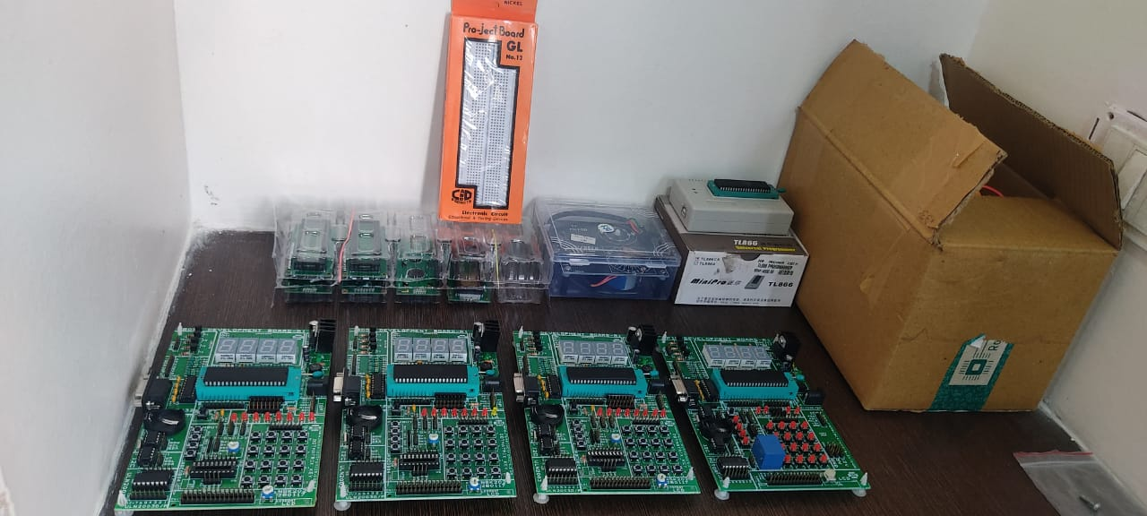
Kits

Slide 9
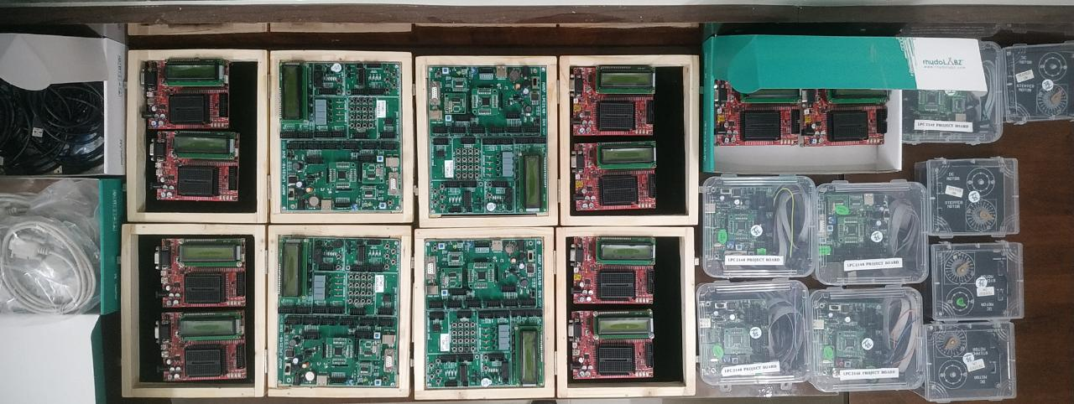
Kits

Slide 10
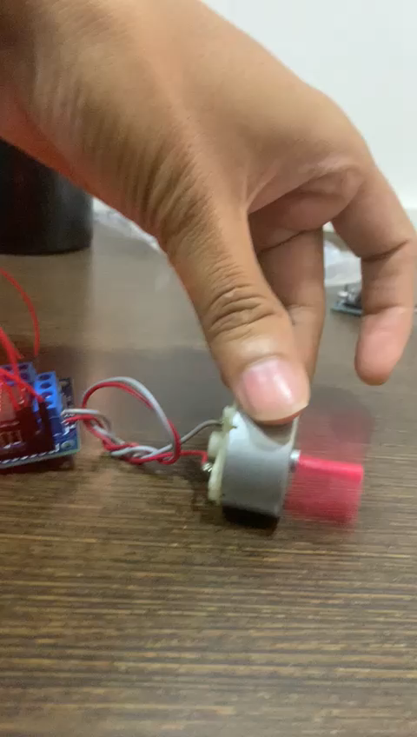
DC Motor interfacing

Slide 11
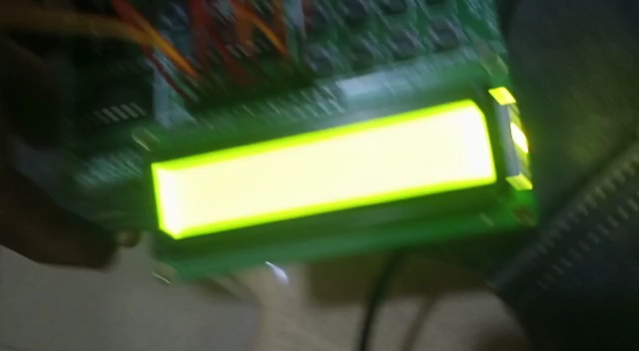
Practical session

Slide 12
CAN communication
Multimaster communication establish
CAN driver development guidance by industrial experts
CAN testing exposure
Overview of CANoe and CANalyzer
Use of CAN controller and CAN trans receiver

Slide 13
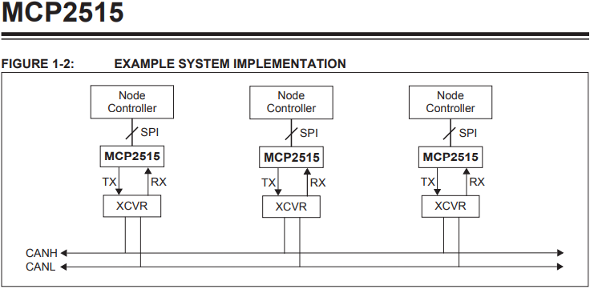

Slide 14
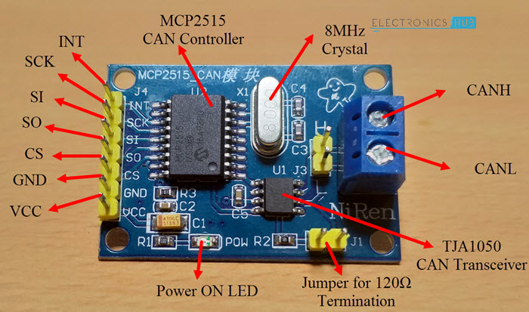
MCP2515 CAN Controller module :

Slide 15
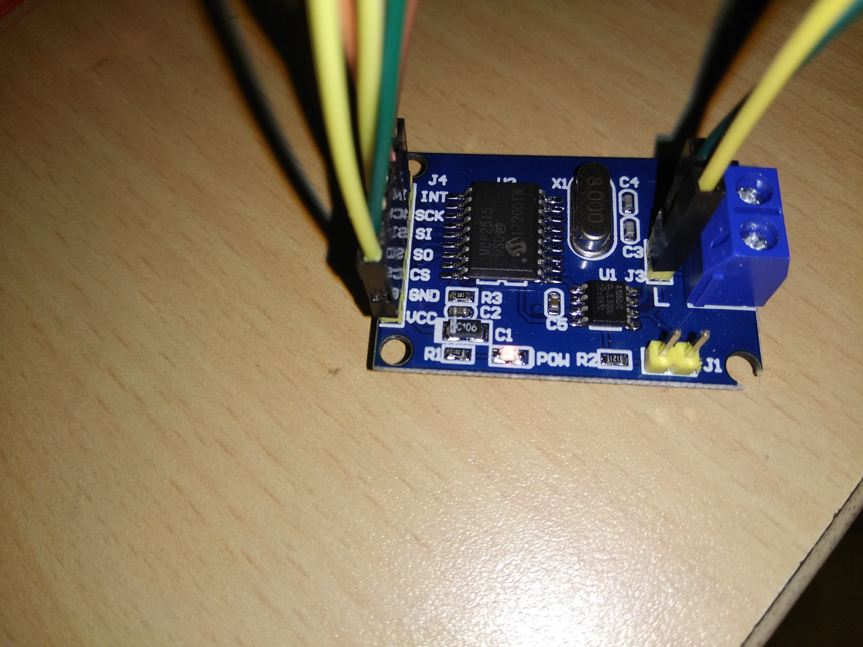

Slide 16
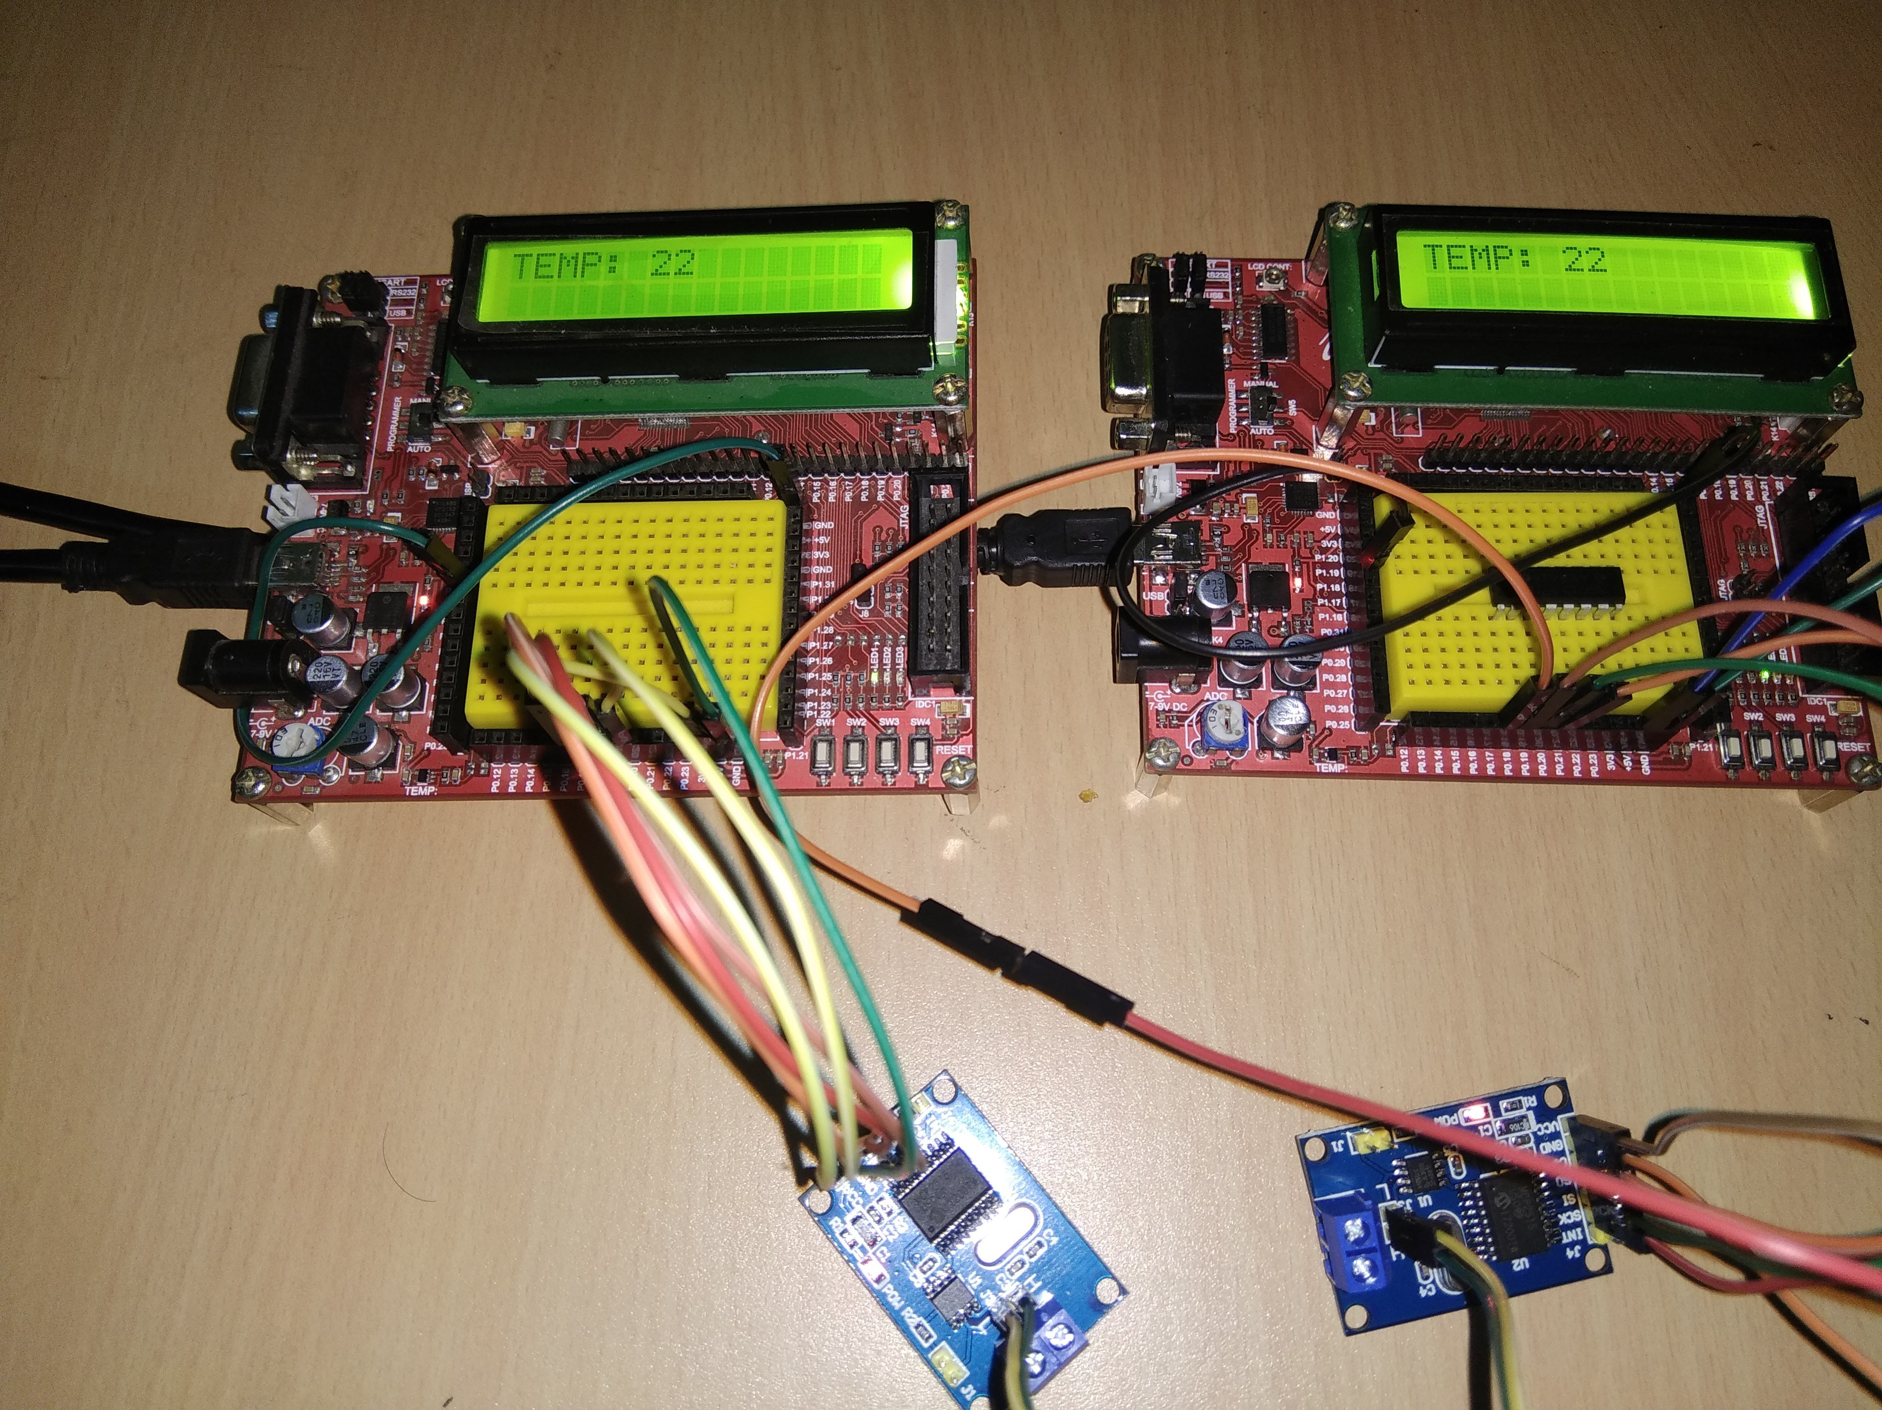

Slide 17
Thank you

